Slide 1

Target Sales Analysis
SQL + Power BI End to End Project
By Sahil Kumar.

Slide 2
🏢Introduction:
Target Corporation is one of the largest retail companies in the United States, headquartered in Minneapolis, Minnesota. Founded in 1902, Target operates as a general merchandise retailer, offering a wide variety of products including apparel, electronics, groceries, home essentials, and beauty items.
With a mission to “help all families discover the joy of everyday life,” Target focuses on delivering quality products at affordable prices while emphasizing customer experience, innovation, and community responsibility.
Target’s business model combines physical stores and digital channels through its strong omnichannel strategy, allowing customers to shop in-store, online, or through same-day delivery options. The company is also known for its “cheap-chic” branding, blending affordability with modern design.
As of recent years, Target continues to strengthen its market position by investing in technology, supply chain efficiency, and sustainability initiatives, making it a leader in the global retail industry.

Slide 3
🎯 Objective:
This project aims to analyze the sales performance, customer behavior, and operational efficiency of Target Corporation, a leading retail company between September 4, 2016 and October 17, 2018 using SQL for data processing and Power BI for visualization and reporting.
The project leverages a comprehensive e-commerce dataset that simulates Target’s business ecosystem, containing data about customers, orders, products, payments, sellers, reviews, and geographic locations. By integrating these datasets, the project provides a 360° view of business performance, uncovering actionable insights that can guide strategic decision-making.

Slide 4
🧩Dataset Overview:
👤1. Table : customers
🗺️ 2 Table: geolocation
Column Name | Description
customer_id | Unique identifier for each customer in the dataset.
customer_unique_id | Permanent unique ID to identify repeat customers across multiple orders.
customer_zip_code_prefix | First part of the customer’s ZIP code representing their geographic area.
customer_city | City where the customer resides.
customer_state | Abbreviation of the state where the customer is located.
Column Name | Description
geolocation_zip_code_prefix | ZIP code prefix used to link customer and seller locations.
geolocation_lat | Latitude coordinate representing the geographical position.
geolocation_lng | Longitude coordinate representing the geographical position.
geolocation_city | City name corresponding to the ZIP code prefix.
geolocation_state | State abbreviation where the location is situated.

Slide 5
🧩Dataset Overview:
🛒 3.Table : Order Items:
⭐4.Table : Order_reviews4
Column | Description
order_id | Unique identifier for the order
order_item_id | Unique identifier for the item in the order
product_id | Identifier of the product being ordered
seller_id | Identifier of the seller fulfilling the item
shipping_limit_date | Latest date by which the item should be shipped
price | Price of the individual order item
freight_value | Shipping cost associated with the item
Column | Description
review_id | Unique identifier for each review
order_id | Identifier of the order being reviewed
review_score | Rating given by the customer (e.g., 1-5)
review_comment_title | Title or summary of the customer’s review

Slide 6
🧩Dataset Overview:
🚚5. Table : Orders
💰6. Table : Payments
Column | Description
order_id | Unique identifier for each order
customer_id | Unique identifier of the customer who placed the order
order_status | Current status of the order (e.g., delivered, shipped)
order_purchase_timestamp | Date and time when the order was placed
order_approved_at | Date and time when the order was approved
order_delivered_carrier_date | Date when the order was handed over to the carrier
order_delivered_customer_date | Date when the order was delivered to the customer
order_estimated_delivery_date | Estimated date for the order to be delivered
Column | Description
order_id | Unique identifier for the order associated with the payment
payment_sequential | Sequence number of the payment for the same order
payment_type | Method of payment used (e.g., credit card, debit card)
payment_installments | Number of installments in which the payment was made
payment_value | Total amount paid for the order

Slide 7
🧩Dataset Overview:
📄7.Table : Products2
🏪8.Table : Sellers
Column | Description
product_id | Unique identifier for each product
product_category | Category to which the product belongs
product_name_length | Length of the product name (in characters)
product_description_length | Length of the product description (in characters)
product_photos_qty | Number of photos available for the product
product_weight_g | Weight of the product in grams
product_length_cm | Length of the product in centimeters
product_height_cm | Height of the product in centimeters
product_width_cm | Width of the product in centimeters
Column | Description
seller_id | Unique identifier for each seller
seller_zip_code_prefix | ZIP code prefix of the seller’s location
seller_city | City where the seller is located
seller_state | State where the seller is located

Slide 8
👤 1. Customer Analytics:
What is the total number of unique customers?
How many customers have more than one account?
Which are the top 10 states with the highest number of customers?
Which are the top 10 cities with the highest number of customers?
Which customer has placed the highest number of orders?
Map the number of customers and sellers per city.

Slide 9
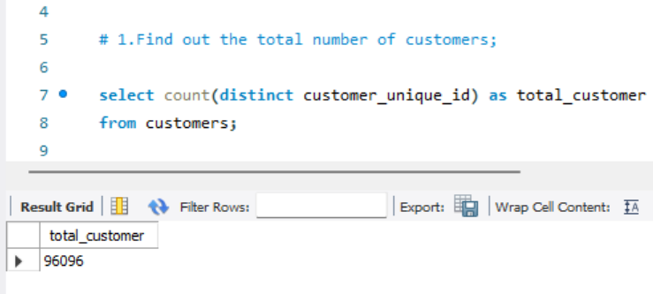
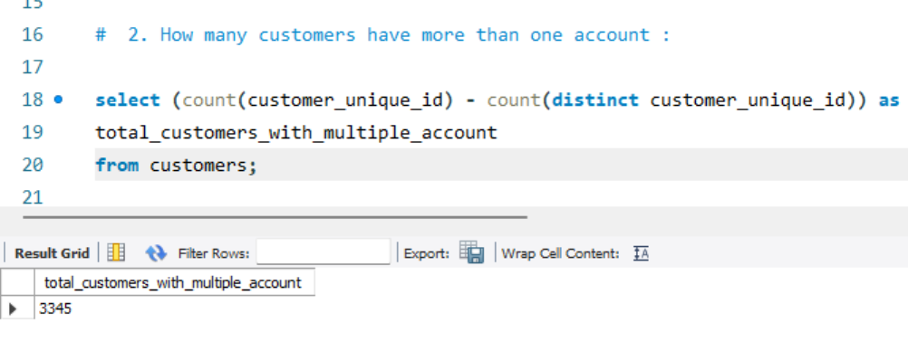
1. Customer Analytics
1.Objective : To understand the size of customer base.
Insight : There are total 96096 customers
2.Objective : To ensure the data accuracy and integrity in customers records.
Insight : There are total 3345 total customers with multiple accounts

Slide 10
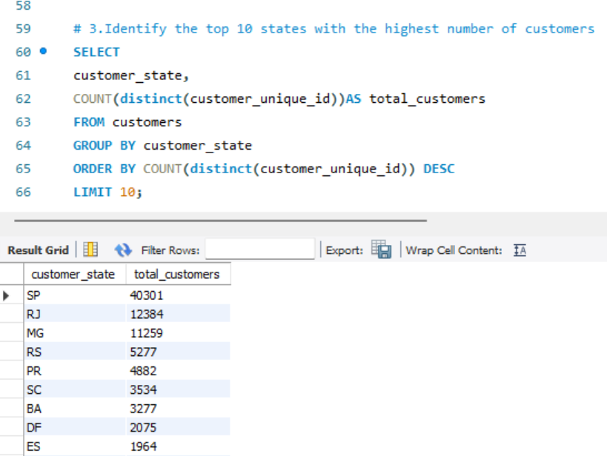
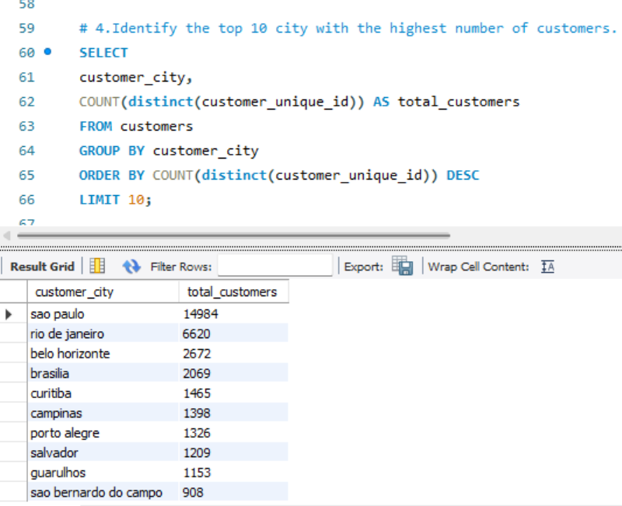
1. Customer Analytics
3. Objective :To understand the geographic distribution of customers.
Insight : SP state has the highest number of customers.
4 Objective : To Supports logistics and delivery optimization by focusing on high-customer-density areas.
Insight: Sao Paulo city has the highest number of customers.

Slide 11
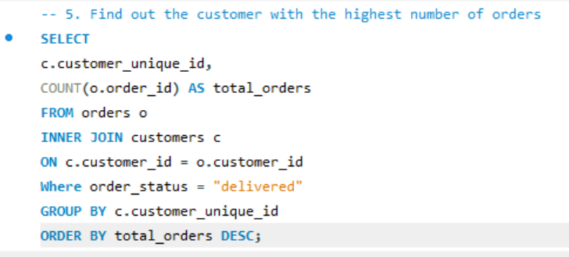
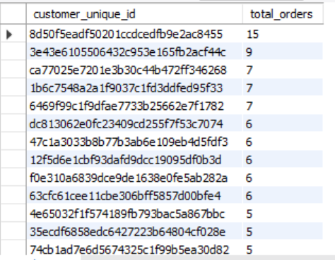
1. Customer Analytics
5.Objective : To determine the most active customers.
Insight : Designing Loyalty programs or rewards campaigns to retain high value customers

Slide 12
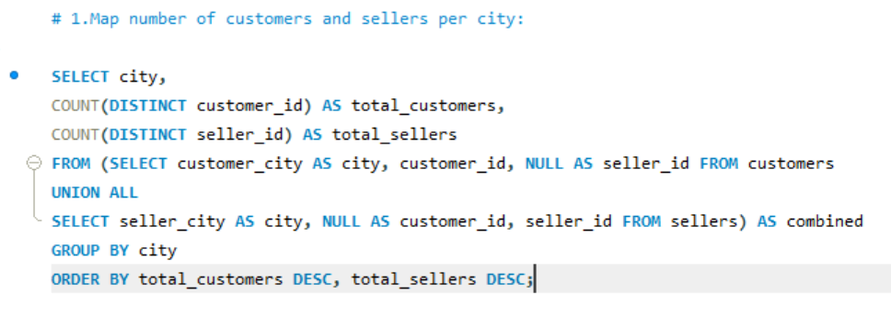
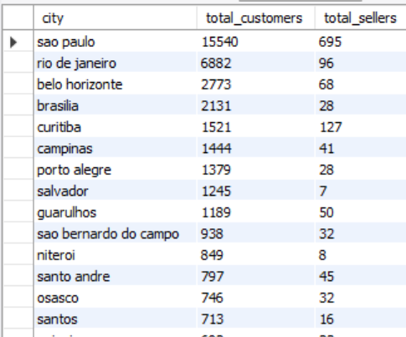
1. Customer Analytics
6.Objective : To analyze the distribution of customers and sellers across cities and identify key market hubs.
Insight : City Sao Paulo has the highest number of customers and sellers

Slide 13
💰2. Sales and revenue Analysis.
What is the total sales revenue generated per month?
Which are the top 10 highest revenue-generating products?
3. Find out the highest generating revenue product category per month.
4. Which are the top 10 states generating the highest revenue?
5. Which are the top 10 cities generating the highest revenue?
6. What is the total monthly revenue and how does it change over time when it is measured using 3 months moving average ?

Slide 14
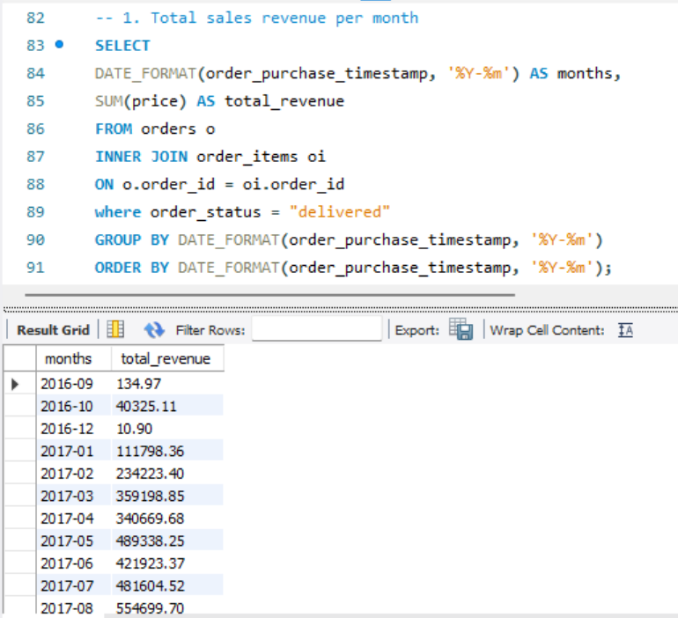
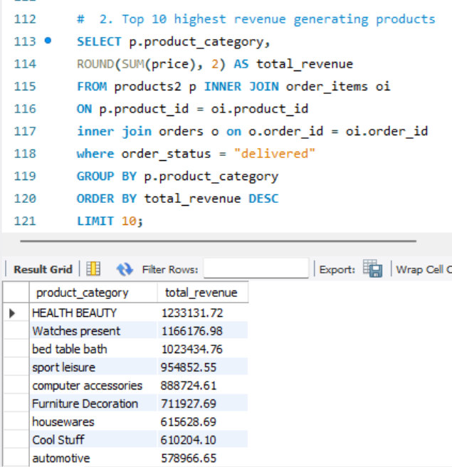
2. Sales and Revenue Analysis
2.Objective : To identify the core revenue driving category.
Insight : Highest revenue is generated by Health Beauty Products.
1.Objective : To track monthly sales performance and business growth over time.
Insight : Highest revenue was generated in November 2017.

Slide 15
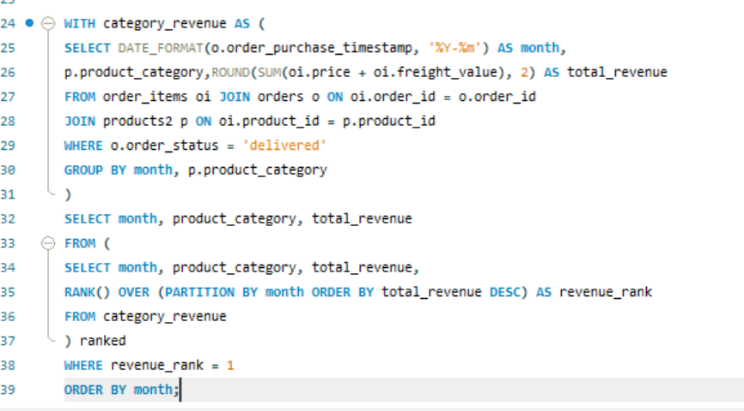
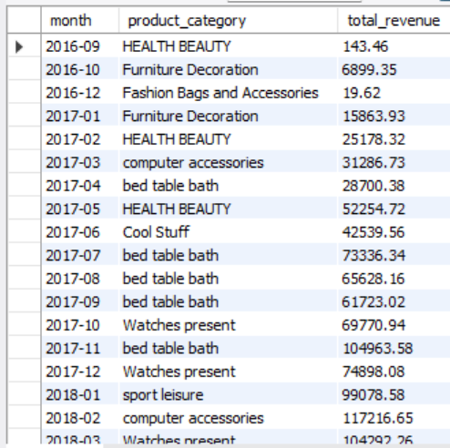
2. Sales and Revenue Analysis
Insight : Maximum time highest total revenue per month is generated by health beauty products.
3.Objective : To find out the Highest Revenue-Generating Product Category Per Month

Slide 16
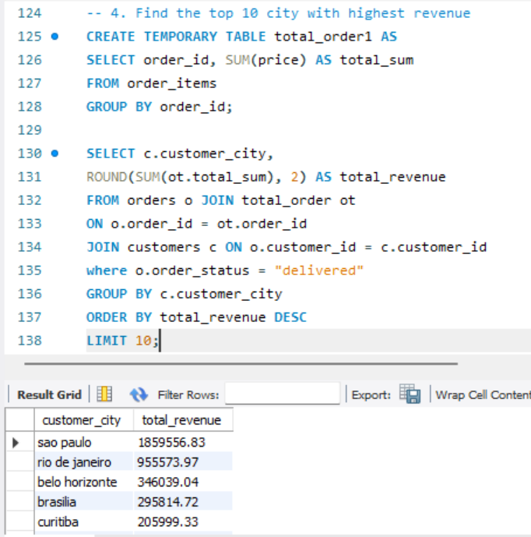
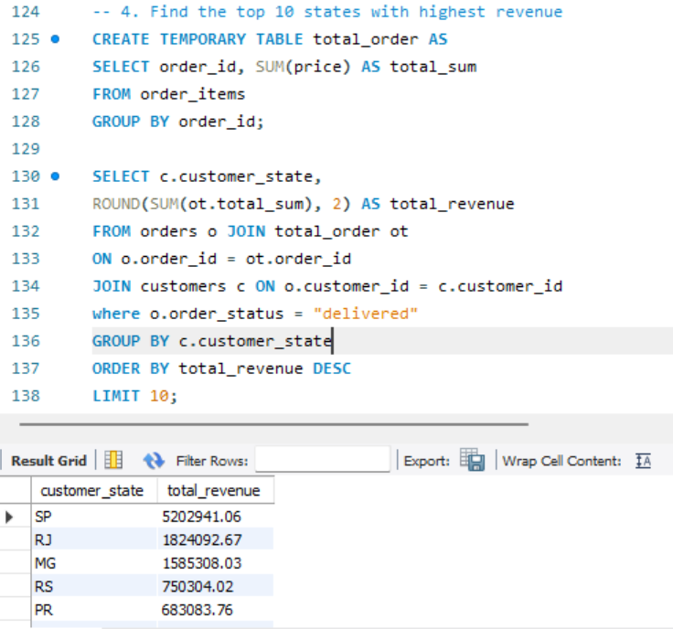
2. Sales and Revenue Analysis
5.Objective : To identify the states which drive the most revenue growth.
Insight : The highest revenue is generated by SP State.
4.Objective : To identify which city drive the most revenue growth.
Insight : The highest revenue is generated by Sao Paulo city.

Slide 17
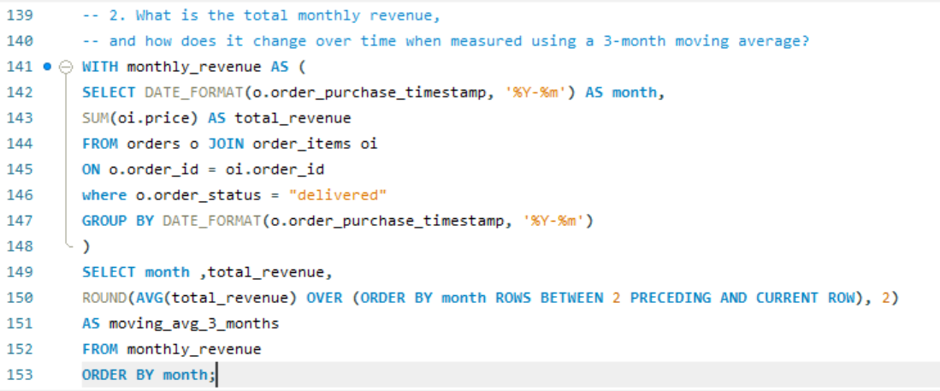
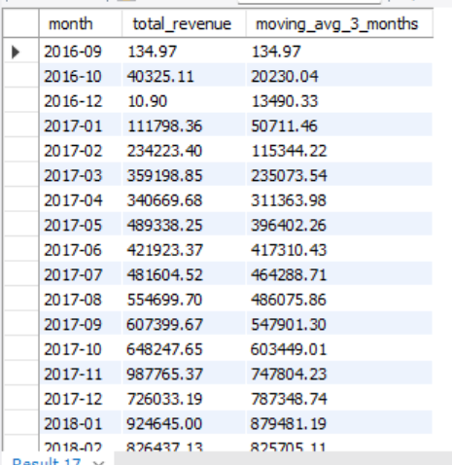
2. Sales and Revenue Analysis
6.Objective :To reveals monthly revenue trends and highlights periods of growth or decline.
Insight : Revenue shows a steady upward trend from early 2017 onward, indicating strong business growth

Slide 18
🚚 3. Order and Fulfillment Analysis
What is the average time taken to deliver an order?
How many orders were delivered late?
Which are the top 3 orders that took the longest time to be delivered?
How many delayed orders are there in each city?
How many delayed orders are there in each state?
What is the order cancellation rate for each month?
How many cities are there in each state?
Compare the delivery time between states (Find out the avg delivery days, fastest delivery and slowest delivery).
At what time of day do customers place the most orders – (morning, evening, afternoon or night)?
Analyze the distribution of order status.

Slide 19
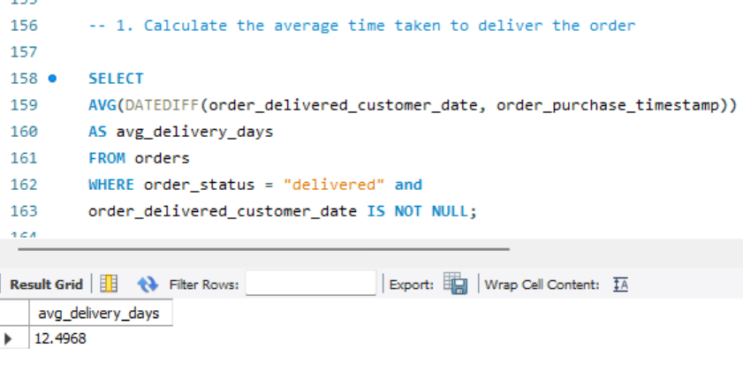
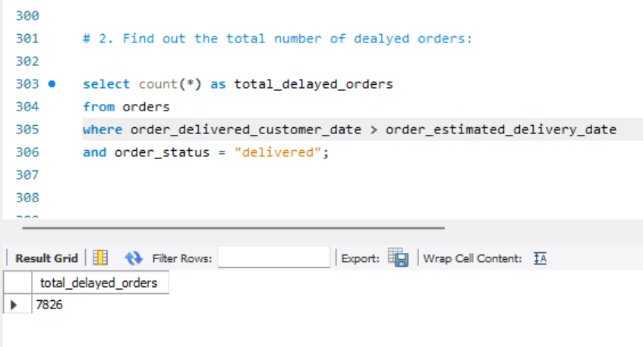
3. Order and Fulfillment Analysis
2.Objective : To understand how often deliveries fail to meet deadlines and where improvements are needed in the order fulfillment process.
1.Objective : To understand how quickly customers receive orders.

Slide 20
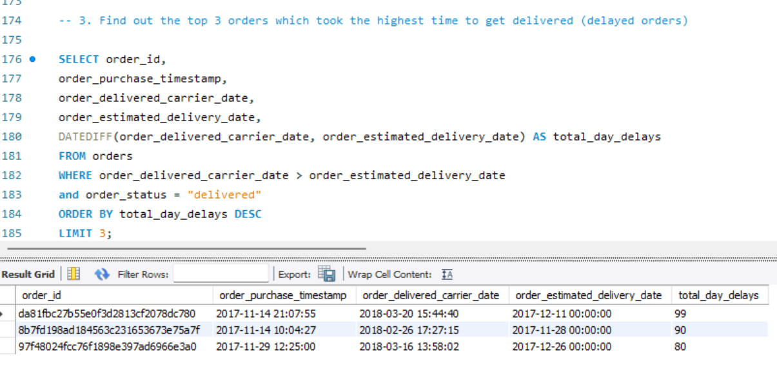
3. Order and Fulfillment Analysis
3.Objective :To highlight outlier cases in delivery performance, helping the company focus on reducing unusually long delivery times.
Insight : The highest time taken by an order to get delivered is 99 days.

Slide 21
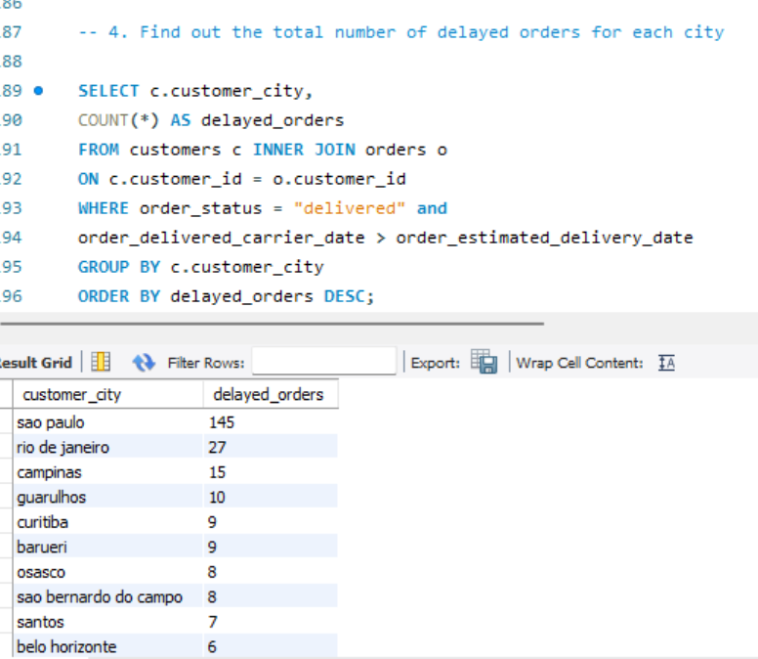
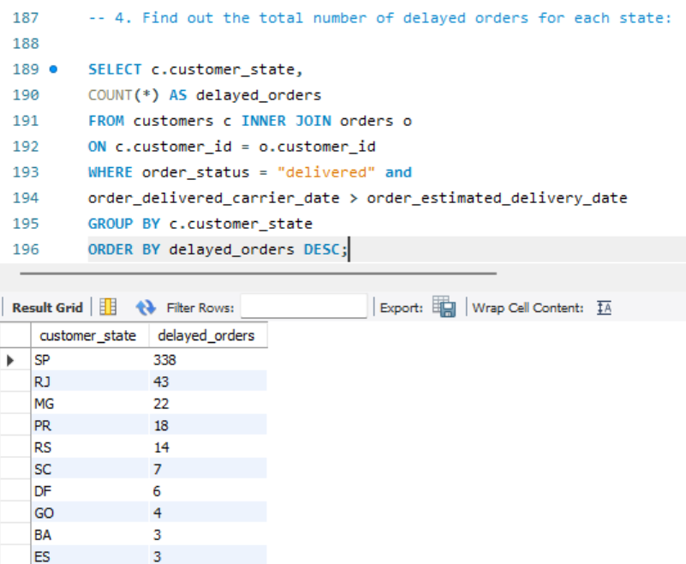
3. Order and Fulfillment Analysis
5.Objective : To find out the state where delivery delays are most common.
Insight : The state with the highest number of delayed order(338) is SP.
4.Objective : To find out the city where delivery delays are the most common.
Insight : The city with the highest number of delayed order(145) is Sao Paulo.

Slide 22
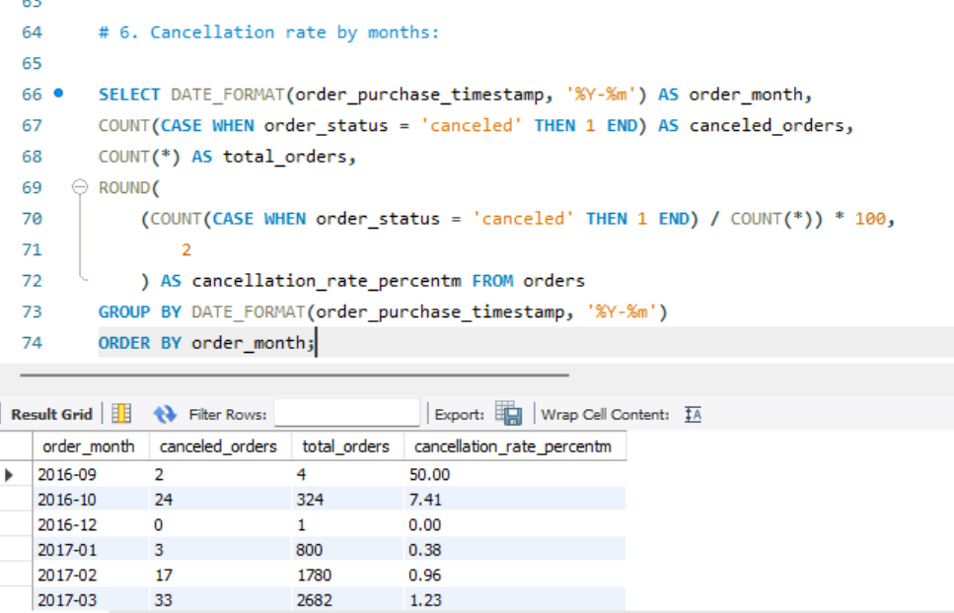
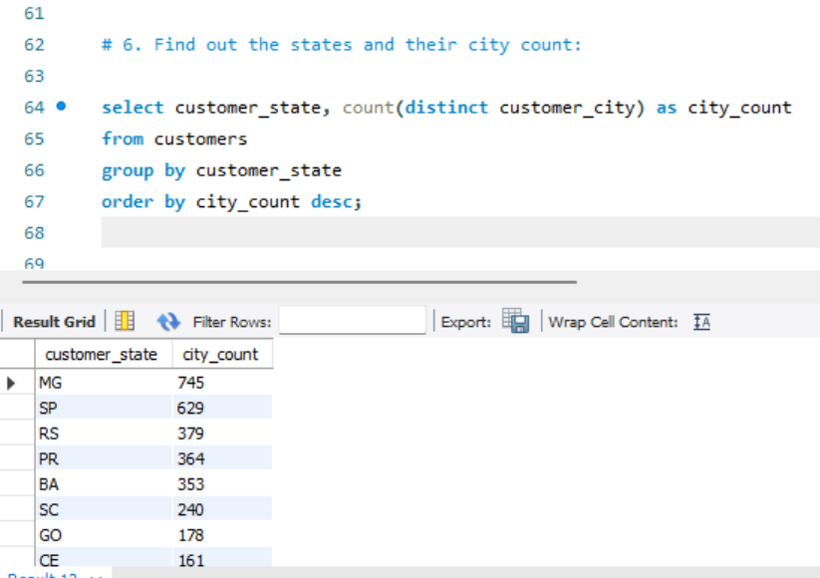
3. Order and Fulfillment Analysis
6. Objective : To identify the order cancellation trends over months:
Insight : Highest cancellation percentage was seen in October 2018 Where total orders were 4 and canceled order were also 4 .
7.Objective : To identify where the most sellers and customers are concentrated
Insight : MG State has the highest number of city (745)

Slide 23
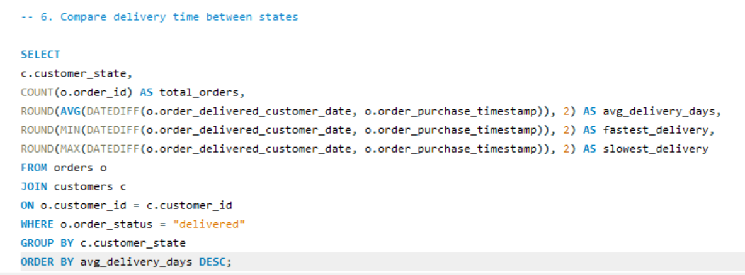
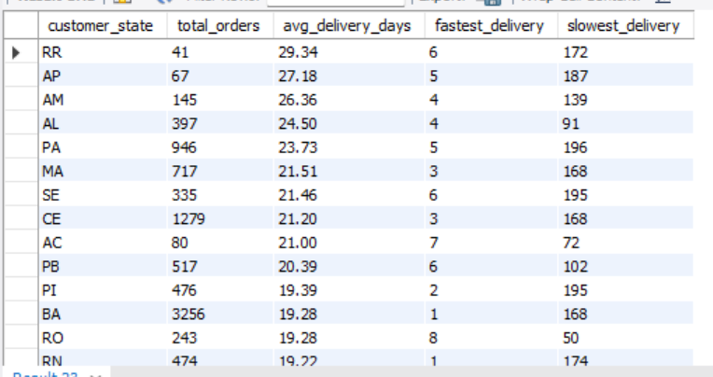
3. Order and Fulfillment Analysis
Insight:
The state with the highest average delivery days is RR, while the lowest is SP.
The fastest delivery record was achieved by the RJ state, with a delivery time of 0 days.
The slowest delivery record is held by the ES state, with a delivery time of 210 days.
8.Objective : To assess the regional delivery performance

Slide 24
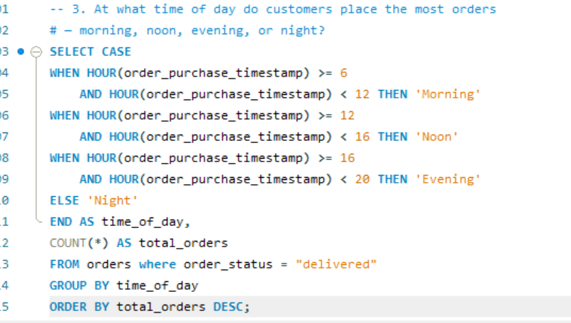
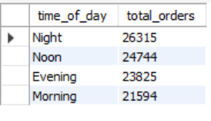
3. Order and Fulfillment Analysis
Insight:
Most customer orders are placed at night (26315 orders), followed by noon (24744 orders) and evening (23825 orders), with the morning (21594 orders) being the least active period.
This indicates that customers are most active during late hours, suggesting that promotional campaigns or ad placements might be most effective during nighttime.
9.Objective :
To identify the time of day when customers are most active in placing orders, helping understand customer purchasing behavior and optimize marketing or operational strategies accordingly.

Slide 25
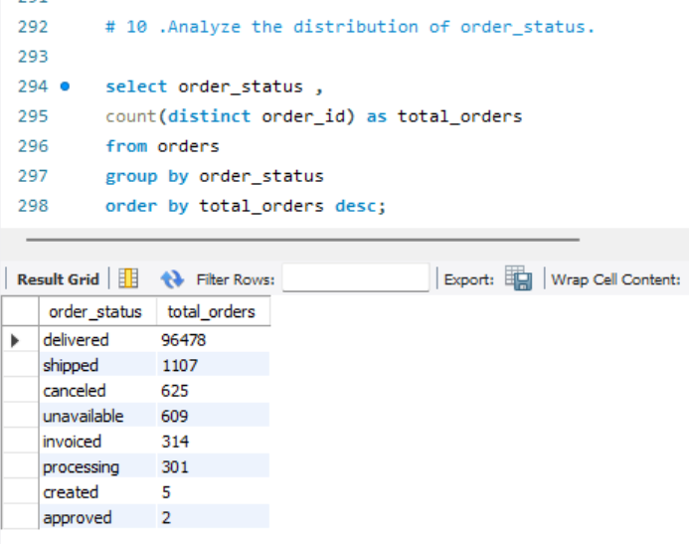
3. Order and Fulfillment Analysis
Objective : To analyze the distribution of order status.
Insight :
The business demonstrates excellent order management, with a very high fulfillment rate (97%) and low cancellation or failure rates (<3%). Future focus can be on analyzing reasons behind the small fraction of canceled/unavailable orders to achieve near-perfect delivery performance.

Slide 26
⭐ 4. Customer Review Analysis:
Calculate the average review score for each product category.
Analyze the distribution of review scores.

Slide 27
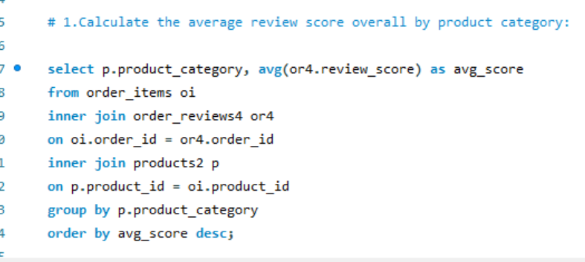
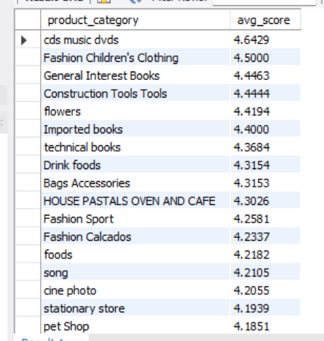
4. Customer Review Analysis
Insight: The CDs, Music, and DVDs category has the highest average review score of 4.6, while the Insurance and Services category has the lowest average review score of 2.5.
1.Objective : To identify which product categories perform best or worst in terms of customer satisfaction

Slide 28
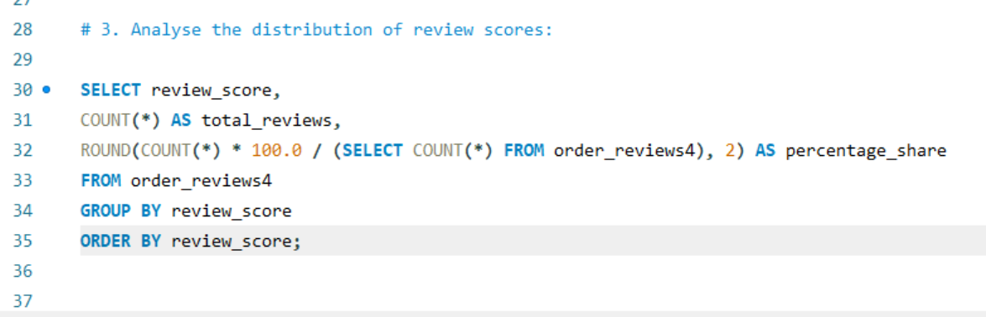
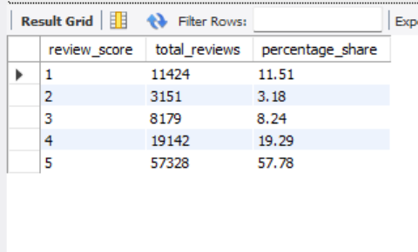
4. Customer Review Analytics
Insight:
Most customers are highly satisfied — 57.78% gave 5-star and 19.29% gave 4-star ratings. Only a small share (11.51% 1-star and 3.18% 2-star) reflects dissatisfaction. Overall, customer sentiment is very positive, though efforts can be made to reduce low ratings through improved service and support.
2.Objective :
To evaluate customer satisfaction trends based on review score distribution.

Slide 29
💳 5. Payment and Transactions Analysis.
How many orders are there for each payment type?
What is the average payment value for each payment type?
What percentage does each installment option represent among all credit card payments?
Which orders have a mismatch between the total payment amount and the sum of the item amount plus freight value? What is the difference for each order?
How many orders are overpaid, underpaid, and correctly paid?

Slide 30
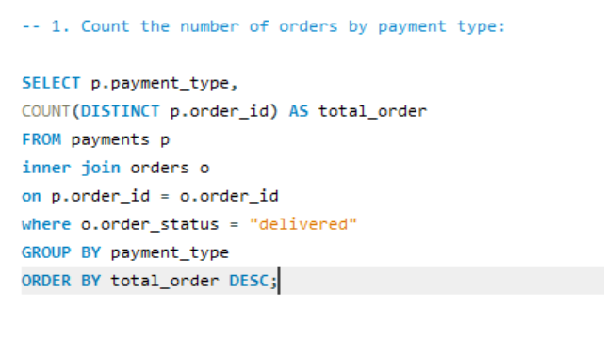
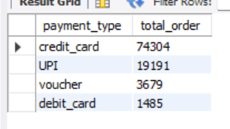
5. Payment and Transactions Analysis
Insight:
Credit cards dominate with 74304 orders, showing strong reliance on credit payments.
UPI ranks second (19,191 orders), indicating growing digital payment adoption.
Vouchers and debit cards are less used.
1.Objective :
To identify the most commonly used payment methods

Slide 31
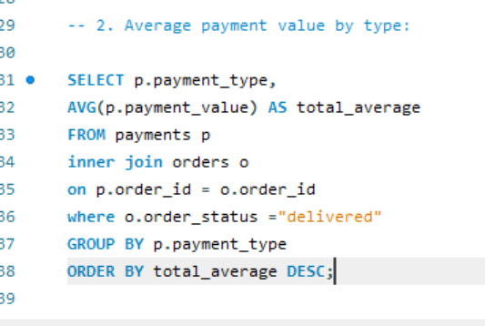
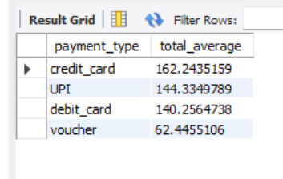
5 Payment and Transactions Analysis
Insight :
Credit cards have the highest average payment value, followed by UPI and debit cards, indicating they’re used for higher-value purchases. Vouchers are mainly used for smaller transactions.
2.Objective : To identify which payment types are associated with higher-value transactions

Slide 32
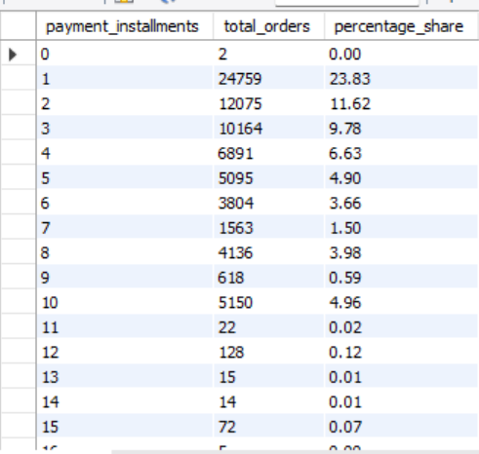
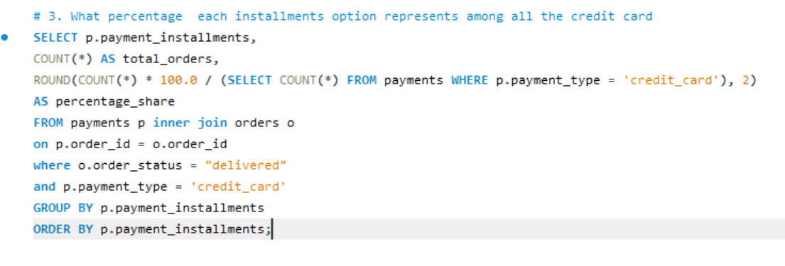
5. Payment and Transactions Analysis
Insight :
Most customers (23.83%) prefer single payments, while 2–3 installments (11.62% and 9.78%) are moderately used. Long-term plans beyond 6 months are rare, showing a clear preference for quick repayment.
3.Objective : To determine the distribution of credit card payments across different installment options, helping to understand customer preferences for paying in full or through installments.

Slide 33
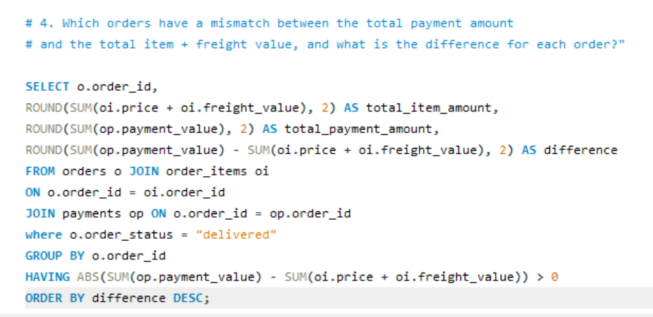
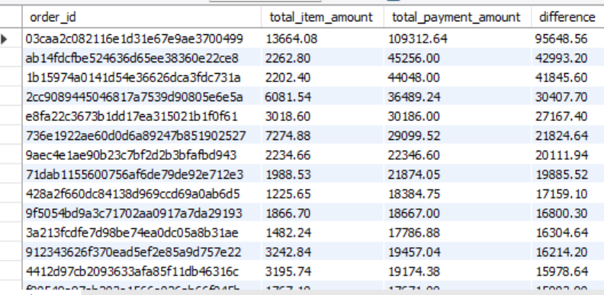
5. Payment and Transactions Analysis
Insight:
Several orders show a significant mismatch between the total payment amount and the sum of item and freight values — with differences reaching up to ₹95,648.56.
This indicates potential data inconsistencies, overpayments, or system calculation errors.
Such discrepancies should be investigated further to ensure accurate financial reporting and maintain transaction integrity.
4.Objective : To identify orders where the total payment amount does not match the expected total (calculated as item amount + freight value).

Slide 34
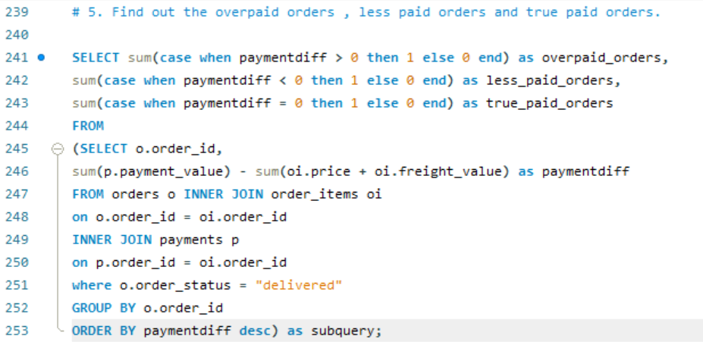
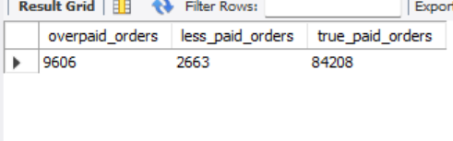
5. Payment and Transactions Analysis
Insight:
Most transactions (84208) are correctly paid, indicating strong payment accuracy and reliable processing.
However, 9606 orders are overpaid and 2663 are underpaid, suggesting occasional discrepancies in billing or data recording.
The company should review payment reconciliation processes to reduce these inconsistencies and ensure financial accuracy.
5.Objective : To classify and quantify orders based on payment accuracy by comparing the total payment amount with the expected total (item amount + freight value).

Slide 35
📦6. Product Performance:
Count the number of products in each category.
Identify the categories with the highest sales volume.
How does the average freight cost of a product vary with its weight?
Which products have low sales (less than 20) but high customer satisfaction (rating ≥ 4.5)?
What is the average number of photos per product category?

Slide 36
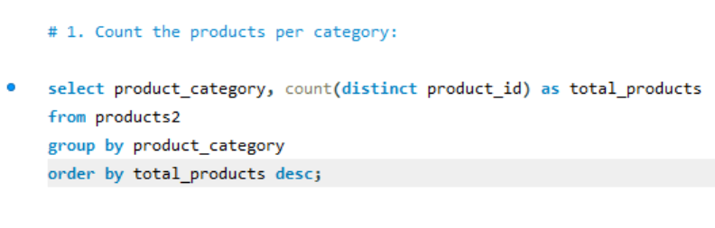
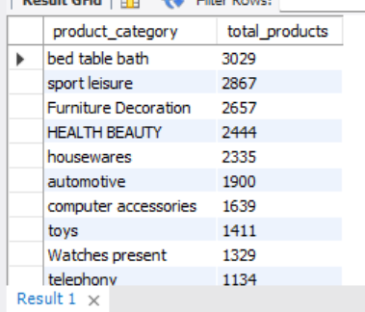
6. Product Performance:
Insight :
The “bed table bath” category leads with the most products (3,029), followed by “sport leisure” and “Furniture Decoration.”
1.Objective : To determine the total number of products available in each category.

Slide 37
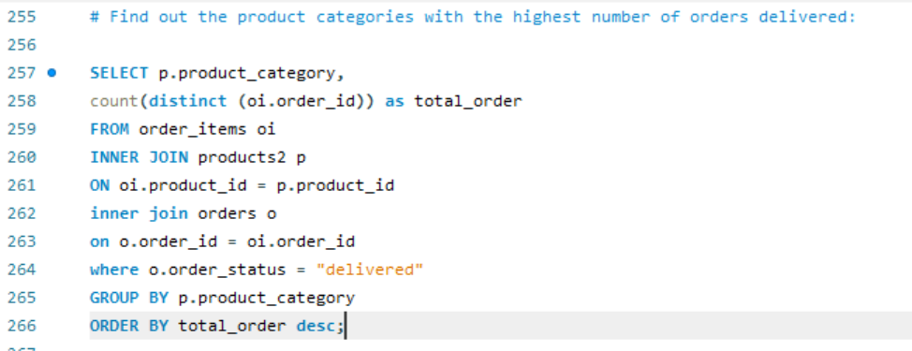
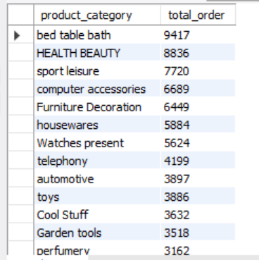
6. Product Performance:
Insight:
Bed Table Bath leads all categories with the highest total delivered order (9417) followed by, Health Beauty and Sports Lesiure showing strong customer interest in personal care and lifestyle products.
2.Objective :
To determine the products category with the highest orders.

Slide 38
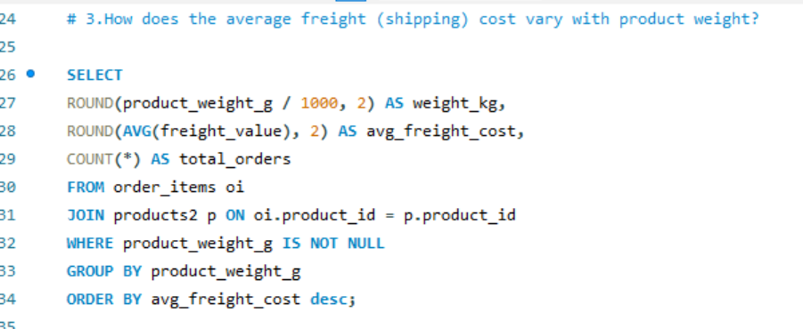
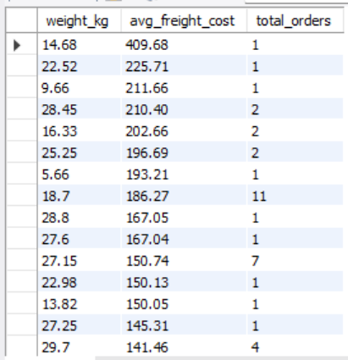
6. Product Performance:
Insight :
The highest avg freight cost is achieved by the order whose weight is 14.68 kg
3.Objective :
To identify whether shipping heavier items leads to higher or lower transportation expenses.

Slide 39
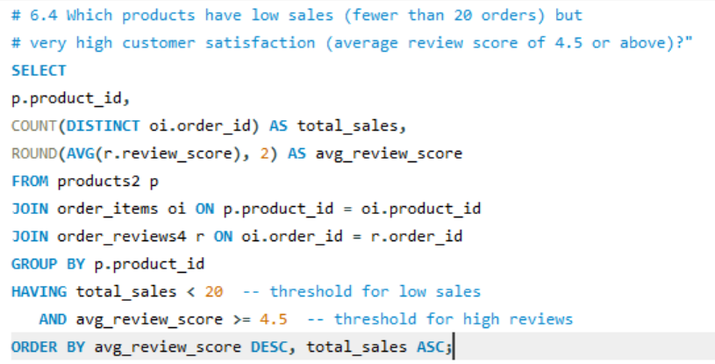
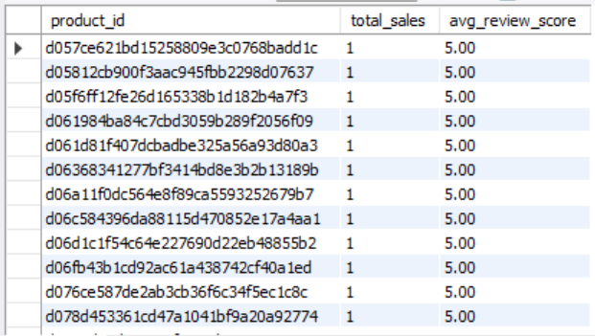
6. Product Performance:
Insight :
All listed products have perfect customer satisfaction scores (5.0) but very low sales (only one unit each).
This suggests that these products are of excellent quality but lack visibility, marketing, or availability — representing untapped potential for sales growth if promoted effectively.
4. Objective :To uncover hidden high-quality items that may need better marketing or visibility to boost sales.

Slide 40


6. Product Performance:
5.Objective :
To understand how visual content varies across categories.
Insight :
Fashion Calcados has the highest number of average photos (5).

Slide 41
🏪 7.Sellers Insight:
Find the number of sellers in each state.
Find the number of sellers in each city.
Identify the states and cities of the sellers who generated the highest total revenue.
Identify the sellers with the highest average review scores.
Calculate the total number of orders handled by each seller.
Identify the sellers with the highest number of delivered orders.
Identify the sellers with the highest cancellation rates.

Slide 42


7.Sellers Insight:
Objective :
2. To identify how sellers are distributed across different city, helping to analyze regional concentration.
Insight : Sao Paulo city has the highest number of sellers(695)
Objective :
1.To identify how sellers are distributed across different states, helping to analyze regional concentration.
Insight : SP state has the highest number of sellers (1849).

Slide 43


7.Sellers Insight:
3.Objective :
To identify the top-performing seller, along with their city and state, generating the highest revenue — helping to understand key markets and successful seller regions.
Insight:
The seller with the highest total revenue(229472) belongs to City Guariba and State SP.

Slide 44


7.Sellers Insight:
Insight :
Sellers with the highest average review scores demonstrate excellent customer satisfaction and service quality. These sellers can be considered top performers, and their practices can be analyzed or replicated to improve overall marketplace standards.
4.Objective :
To identify the sellers with the highest avg review scores.

Slide 45


7.Sellers Insight:
Insight :
The top seller handled 1,854 orders, followed closely by others with over 1,800 orders, indicating high sales concentration
5.Objective : To identify top-performing sellers.

Slide 46


7.Sellers Insight:
6.Objective : To identify the most successful sellers
Insight : Highest number of order delivered by a seller is 1819

Slide 47


7.Sellers Insight
7.Objective :
To highlight potential issues in seller reliability, inventory management, or fulfillment processes.
Insight:
Sellers with high cancellation rates may be negatively impacting customer satisfaction and trust. These sellers should be reviewed for operational inefficiencies, policy violations, or support needs to improve overall marketplace performance.

Slide 48


Slide 49


Slide 50


Slide 51


Slide 52
Conclusion: The analysis of Target Corporation’s e-commerce sales (2016–2018) reveals a strong and growing retail performance driven by a few key product categories, regions, and customer behaviors:
Category | Insight | Reason / Interpretation
1. Sales Growth | Monthly revenue showed a steady upward trend throughout 2017, peaking in November 2017. | The rise was mainly due to Black Friday promotions, holiday shopping season, and increased e-commerce activity during Q4.
2. Top-Performing Categories | Health & Beauty and Bed, Table & Bath were the highest revenue-generating categories. | Reflects strong consumer preference for personal care and lifestyle products, which are recurring purchase items.
3. Geographic Insights | São Paulo (SP) dominates both in customer base and total revenue. | São Paulo is Brazil’s largest economic hub with high population density and online shopping adoption, but overreliance poses market concentration risk.
4. Operational Efficiency | Overall 97% order fulfillment rate, though states like RR and ES faced long delivery times (up to 210 days). | Indicates strong order processing efficiency overall, but logistical and distance-related challenges in remote regions.
5. Delivery Delays | Most delayed and canceled orders occurred in São Paulo. | Heavy demand and logistics congestion in high-order regions likely caused delivery bottlenecks.

Slide 53
Category | Insight | Reason / Interpretation
6. Customer Satisfaction | Most reviews are 4–5 stars, showing strong satisfaction; however, Insurance & Services received lower ratings. | Indicates overall positive customer experience, but certain categories need quality and service improvements.
7. Payment Behavior | Credit cards are the most used and highest-value payment method, with short-term installments preferred. | Reflects consumer trust in digital payments and a tendency toward quick repayment rather than long-term financing.
8. Payment Accuracy | Some orders show mismatches between total payment and expected value (over/underpayments). | Suggests possible data entry errors or system reconciliation issues, requiring stronger financial controls.
9. Product Insights | Several products have excellent ratings (5.0) but very low sales. | High-quality items may lack visibility or marketing support, representing untapped sales potential.
10. Seller Insights | Top sellers perform strongly, but some have high cancellation rates. | Indicates operational or reliability issues among certain sellers, impacting customer trust and delivery performance.

Slide 54
💡Recommendations to Boost Sales
Expand Beyond SP Region:
Diversify marketing and logistics to high-potential but underperforming states to reduce dependency on SP.
Offer regional promotions to attract new customers.
Strengthen Logistics & Delivery:
Focus on states with high delivery delays (e.g., RR, ES) — optimize routes, strengthen last-mile delivery, and partner with local courier services.
Set delivery time SLAs and performance incentives for sellers.
Enhance Customer Retention:
Introduce loyalty programs and personalized offers for frequent buyers identified in the dataset.
Provide discounts or rewards for repeat purchases in high-value categories like Health & Beauty.
Product Visibility & Marketing:
Promote highly rated but low-selling products through featured listings, influencer marketing, or targeted ads.
Bundle complementary items (e.g., Health + Beauty combos) to increase average order value

Slide 55
💡Recommendations to Boost Sales
Improve Low-Rated Categories:
Investigate Insurance & Services for poor reviews — possibly due to unclear product descriptions, service delays, or unmet expectations.
Payment Accuracy & System Checks:
Audit payment calculation logic to fix mismatches between payment value and expected total (price + freight).
Automate reconciliation reports to flag inconsistencies early.
Seller Performance Optimization:
Identify sellers with high cancellation rates and provide training or process audits.
Replicate best practices from top-rated sellers across the platform.
Timing of Promotions:
Since most orders are placed at night, schedule digital campaigns and flash sales during late hours to maximize visibility and conversions.

Slide 56
1.Sales Growth:
Monthly revenue showed a consistent upward trend throughout 2017, peaking in November 2017.
Reason: November 2017 sales peaked due to the combined effects of Black Friday discounts, holiday shopping behavior, strong online marketing, and a recovering economy.
Recommendation: Plan strong November Black Friday campaigns with exclusive discounts, free shipping, and bundle offers, while using past data to forecast demand and optimize inventory and staffing.

Slide 57
Conclusion: The analysis of Target Corporation’s e-commerce sales (2016–2018) reveals a strong and growing retail performance driven by a few key product categories, regions, and customer behaviors:
1.Sales Growth:
Monthly revenue showed a consistent upward trend throughout 2017, peaking in November 2017.
Reason: November 2017 sales peaked due to the combined effects of Black Friday discounts, holiday shopping behavior, strong online marketing, and a recovering economy.
Recommendation: Plan strong November Black Friday campaigns with exclusive discounts, free shipping, and bundle offers, while using past data to forecast demand and optimize inventory and staffing.
2.Top-Performing Categories:
Health & Beauty and Bed, Table & Bath were the highest revenue-generating and most-ordered categories, reflecting strong consumer interest in personal care and lifestyle products.
3.Geographic Insights:
Sao Paulo (SP) dominates both in customer base and revenue generation, making it the most valuable region. However, this also introduces a dependency risk — diversification into other states could balance growth.

